Slide 1



9. Statistics Page
STATISTICS
Requirement Elicitations
_Ming
Requirement Analysis
System Design
1
Object Design
Level 10
4960points
MVC Design Patterns

Slide 2






Filter to show the ranking of the leaders either in the cohort format or the class format
10. Leaderboard Page
Filter
LEADERBOARD
Select a type
Lab Class
Cohort
Display the ranking of the leaders in the cohort or the class.
1
_Ming
Level 10 4960points
_Ming
2
ly4ly4ly4
Level 10 4860points
1
3
SynC
Level 9 3860points
Level 10
4960points
Shows the current ranking of the user, the level and the points that user currently has.
4
Sana
Level 8 3550points

Slide 3

11. Assignment Page
ASSIGNMENTS
Tap on New Assignments.
Go to Enter Code Page (12)
New Assignment
Tap on Past Assignments.
Go to Past Assignments (13)
Past Assignment

Slide 4

12. Enter code Page
Enter code provided by teacher
Students would have to key in the code provided by teacher to access assignment
Proceed
Upon entering a valid code, students can press proceed to begin the assignment.

Slide 5

13. Past Assignment Result
PAST ASSIGNMENT RESULTS
Assignment | Results
1 – Requirement Analysis | 8/10
2 – Use Case | 7/10
3 - Class Diagram | Not yet attempted
4 – UML Model | Not yet released
Show the past assignments that
Users have attempted and the results of the assignments.

Slide 6

14. PVP Challenge Page
PVP CHALLENGE
Tap on Create Challenges.
Go to Selecting a player to challenge Page (15)
Create Challenges
Tap on Pending Challenges.
Go to Pending Challenge Page (20).
Pending Challenges
Results
Tap on Results Pages.
Go to Challenge Results Page (21).

Slide 7


15. Selecting a player to challenge Page
Select a player to challenge
Tap on Select a player to select a player to issue the challenge to.
Select a player
SynC
ly4ly4ly4
Jason
Tap on Proceed to Selecting a world for challenge Page (16)
Proceed

Slide 8

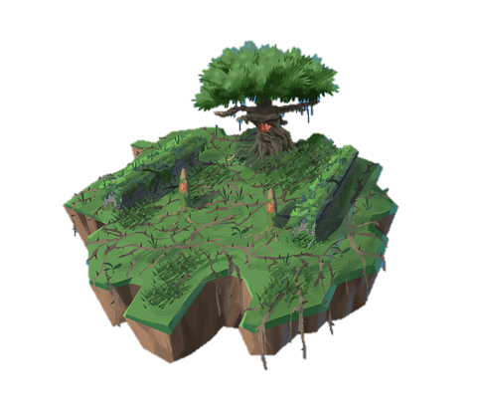

16. Selecting a world for challenge Page
Select a world
Requirement Engineering
Player can choose the world (the chapters) for the challenge.
Subject description will be written here.
Tap on Selecting a difficulty for challenge Page (17)
1. Requirement Engineering
Proceed

Slide 9
17. Selecting a difficulty for challenge Page
Select the difficulty level
Tap on Select a level to select the difficulty level
Select a level
Easy
Medium
Hard
Tap on Selecting the number of questions for challenge Page (17)
Proceed

Slide 10
18. Selecting the number of questions for challenge Page
Select the number of questions
Tap on Select to select the number of questions for the challange
Select no. of qns.
10
15
20
Tap on Complete to go to Successfully creation of a challenge Page (19)
Complete

Slide 11



19. Successfully creation of a challenge Page
Players will be notified that challenge has been created and user has to complete the challenge before the challenge will be issued to the opponent.
You have successfully created a challenge!
Challenge would be issued to player once you have attempted the same challenge.
Share
Attempt
Tap on Attempt to start the challenge.
Tap on Share to share the challenge on social media to alert your friends that they have been challenged.

Slide 12

20. Pending Challenge Page
Pending challenge shows the relevant information about the challenges that are pending and expired. Players can also accept the challenge over here.
Pending Challenges
Issued by: | World: | Qns | Difficulty | Available | Accept
Sana | Requirement Engineering | 10 | Easy | Yes
ly4ly4ly4 | Requirement Engineering | 15 | Hard | No | Expired
CHALLENGE

Slide 13


21. Challenge Results Page
Challenge Results shows the relevant information of the challenge after both players have completed the challenge.
Challenge Results
Issued by: | World: | Qns | Difficulty | Your Score | Opponent Score
Sana | Requirement Engineering | 10 | Easy | 8/10 | 7/10
Jason | Requirement Engineering | 15 | Medium | 9/15 | 10/15
A trophy icon would be shown on the score that has a higher score. It would also mean that the player that has the icon has a higher score and won the challenge.

